Slide 1
Notes
Each slide contains notes at the bottom of the page. Please note the notes are not intended to be read like a script but contain helpful additional information and may be useful if you are asked questions.
Use discretion with some topics depending on the age of the children. Remember you are there to describe Humanism, not to criticise and challenge religion. It is often best not to focus on arguments for and against the existence of a god or an afterlife, but better to simply state that humanists see no evidence for either, then present the positive values of Humanism.
Try and bring in your personal story by explaining how your Humanism affects your daily life, how you make moral decisions, and how you make your own life meaningful.
There is almost certainly more material here than you will need for an assembly or an in-class introduction to Humanism so discuss with the teacher first what they would like you to focus on. The presentation includes questions which may or may not be appropriate depending on who you are presenting to and how much time you have.

Slide 2
Slides Info
1) Notes
2) Slides info
3) Title
4) Human beings - We are all human
5) Human beings - The importance of human beings
6) Human beings - Celebrating humanity
7) Key humanist beliefs
8) Is Humanism a religion?
9) Understanding the world - The importance of questions
10) Understanding the world - Why do people believe things?
11) Question
12) Understanding the world – Reason and science
13) Understanding the world - Science
14) Understanding the world - Evidence
15) Question
16) Atheism and agnosticism
17) Atheism and agnosticism
18) Question
19) Atheism and agnosticism - Problem of evil
20) Death
21) Death - making the most of life
22) Question
23) Meanings in life
24) Happiness
25) Happiness
26) Happiness
27) Happiness
28) Celebration and ceremonies
29) Christmas
30) Morality – why be good?
31) Morality – rules
32) Morality – the golden rule
33) Morality – responsibility, 34) particulars, empathy, reason
34) Morality – natural
35) Morality
36) Humanism in practice
37) What kind of world do humanists want?
38) Wonder
39) What does it mean to be a humanist?
40) The BHA
41) Humanist history
42) Data
43) Humanist celebrities
44) Humanism is positive
45) Conclusion
Notes:
There is almost certainly more material here than you will need for an assembly or an in-class introduction to Humanism so discuss with the teacher first what they would like you to focus on. The presentation includes questions which may or may not be appropriate depending on who you are presenting to and how much time you have.
The list of slides above should help you find the right material if you have been asked to talk about something specific (e.g. morality, happiness, understanding the world).
If you are doing a short, general introduction to Humanism, then the slides highlighted in red might be the most appropriate. You may of course want to refer to some of the notes on the other slides.

Slide 3
What is Humanism?

Slide 4
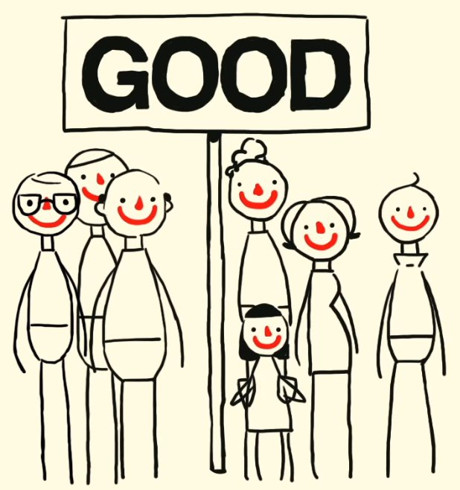
We are all human
Notes:
Begin by emphasising what we all share. This is important for humanists.

Slide 5
We are all human
Humanists…
Think all human beings are valuable
Focus on human happiness when deciding how we should live
Think humans can do great things and celebrate our achievements
Notes:
Begin by emphasising the importance of human beings and being human for humanists
Many religions place a deity, a holy book, or a transcendental realm at the centre of their thinking
Humanists place human beings at the centre
They value all human beings, their differences, and that which we have in common
They value human life
They recognise our common humanity and our shared human values
They place human beings and human wellbeing at the centre when making decisions about how they should live
They are optimistic about human nature and celebrate our many achievements
They believe human beings have the power and potential to do great things
NB. This does not mean they do not value other things
Many humanists place great value on all living things, especially other sentient creatures, and on the planet we live on

Slide 6





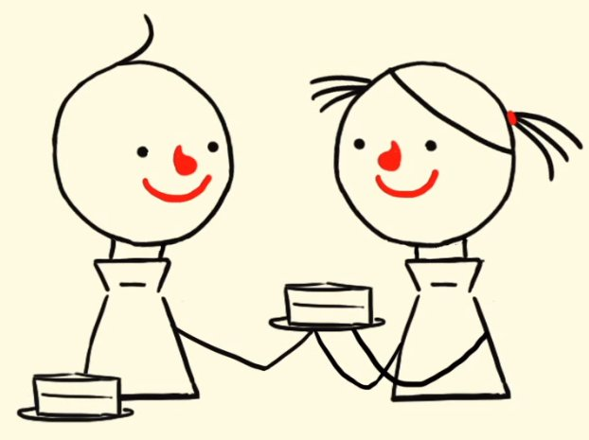
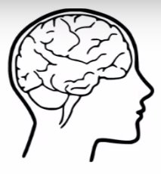

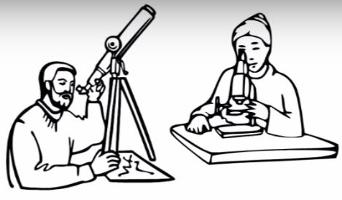

Celebrate humanity
Notes:
Human beings are special
Human beings have achieved spectacular things: electricity, medicine, transport, science, art, music, architecture. technology
Humanists also value many other things that human beings are capable of: love, friendship, creativity, humour
Humanists also celebrate the human capacity to be good to each other: empathy, kindness, compassion, respect

Slide 7
What does it mean to be a humanist?
Humanists believe that…
We should think for ourselves about what is right and wrong and be good to others
We only have one life and we should make the most of it
We can use science to help us understand ourselves and the world
We should try to be happy and help others to be happy too
Notes:
Explain you will talk in more detail about each of the above later
Humanism is a label for a range of beliefs and values: not all humanists agree about everything but most humanists would agree on the above

Slide 8
Is Humanism a religion?
No.
It is a philosophy, an attitude, or an approach to life.
It asks many of the same questions religions ask:
How can I understand the world around me?
Why should I be good?
How can I live a meaningful life?
Notes:
Be clear that you are there to say what are your beliefs and values, not to impose your views on others or criticise anyone else’s beliefs
Unlike religions, Humanism makes no claims about supernatural or transcendental beings of forces
It has no reliance on faith for knowledge, only on reason, evidence, and experience
One of the key differences between Humanism and religions is that nothing in Humanism is beyond question. Humanists are prepared to change their beliefs when presented with new evidence
‘It is an attitude towards the task of thinking about how to live a life worth living, both for the person living it and for its impact on others.’ A.C. Grayling

Slide 9
The importance of questions
Who has a good question?
Notes:
Ask students to come up with some interesting question about anything (not just about Humanism)
Praise their questions
Don’t worry about trying to answer them
One other thing that is special about human beings is our ability to ask questions, to look for answers, and to find answers
One of the most special things about being human is our curiosity. We can ask questions and explore the world to discover new things.
If we ask good questions and think carefully about how to answer them, we can make the world a better place.
You can never have too many questions!
We should try and stay curious throughout our lives: we may never know everything but that shouldn’t stop us from asking questions.
Other questions you can ask:
What questions have changed the world?
Are easy questions or difficult questions more interesting?
Should we always accept the first answer we are given?
Does every question have an answer?
Humanists also think that human beings are special because we can find out answers for ourselves. This is called reasoning: thinking carefully about what the answer might be and using evidence to guide us.

Slide 10
Why do people believe things?
I use evidence to decide whether something is true. Then I test it to make sure.
I believe everything people tell me and what I read in books.
I just know what is true.
I think very carefully about what I believe to make sure I am not making a mistake.
Notes:
Ask what reasons the children have to believe things
Do they think the reasons above are good reasons?
Humanists use the reasons on the right

Slide 11
Question
Have you ever got something wrong?
Did you used to believe anything that you now know is not true?
Notes:
How can our beliefs be mistaken?
Illusions
Hallucinations
Lying
Bias
Mistakes
Possible for many people to be wrong about the same thing (e.g. Earth orbiting Sun)
Wanting something to be true is not knowing
Poor tests
Flawed logic

Slide 12
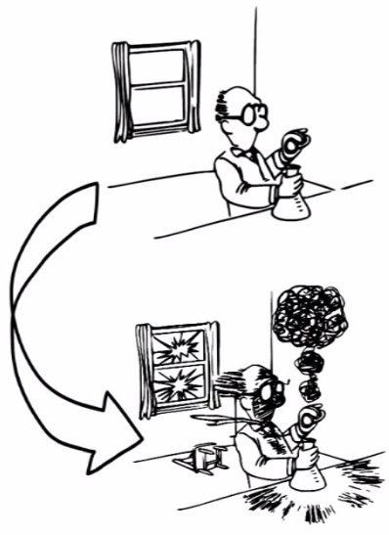

Making sense of the world
Humanists use science and reason to understand the world
Working things out
Experiments
Thinking
Reason and Science
Evidence
Logical argument
Predictions
Notes:
Humanists celebrate our ability to understand the world we live in.
Humanists believe in the importance of reason and evidence to decide what to believe. They believe that scientific investigation and testing is the best way to find out facts about the world.
Science tells us to find truth we must first observe the world around us and form hypotheses. We then ask what would happen if such a hypothesis were true and make predictions. We then test those predictions with experiments and look for evidence our hypothesis is correct. We should then use further testing to recheck our hypothesis and form a conclusion.
Extension question: What counts as good evidence?

Slide 13
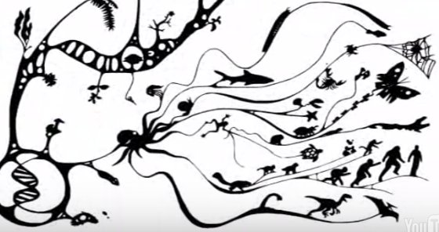
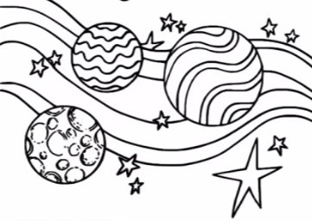
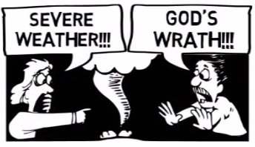
Science is successful
Science has been incredibly successful at answering questions about the world
… and at disproving the beliefs of our ancestors
Notes:
Humanists believe science is important for several reasons
Curiosity: human beings have a psychological desire for truth - we don’t want to live lives based on untruths
Benefits: new technology and social justice – science has helped us to cure disease, taken us to space
Enriches our lives: the fact we can learn about the world gives value to humanity
‘The good life is one inspired by love and guided by knowledge’
(Bertrand Russell, 1872-1970)
Science is able to answer many of the questions we were unable to answer in the past or correct the answers we previously had. E.g.
What causes bad weather and natural disasters?
What causes disease?
Why does it look like the Sun orbits the Earth?
What are we made from?
Why do living things appear designed for the world they live in?
Why is there such diversity of life?
Why do certain things appear beautiful?
Where do human beings come from?
How did the universe begin?
Some questions we still do not have the complete answer for, however, many humanists believe that the history of scientific progress has taught us that we should be cautious before invoking supernatural explanations.
It’s not surprising that people in the past might have explained natural phenomenon using supernatural ideas: without greater knowledge of the natural world it would have been difficult to explain why the sun rose and set or people became ill. Science has given us a better way to answer these questions and to test our answers.

Slide 14

The importance of evidence
Humanists…
Look for evidence before they believe things
Won’t simply trust what someone else tells them
Are open-minded
‘A wise man proportions his belief to the evidence.’
David Hume
Notes:
Some people believe faith, revelation, and the authority of sacred texts can reveal truth. Humanists do not.
Many humanists are wary of the ‘wisdom’ of powerful people because they can often use mistruths to help cement their power or tell us what we want to hear to remain popular.
Many humanists do tend to trust what scientists tell them. Humanists recognise that we can’t test everything ourselves and so sometimes we have to trust what we read or the information provided by other people. However, they think we should always think carefully about the claims made by others and if we are unsure we should check using other sources of evidence. We might not be able to test everything for ourselves, but being able to test claims is important for humanists. The claims made by science can be tested so we can investigate whether to trust them or not.
They recognise that scientists sometimes make mistakes. And humanists recognise that science does not give us certainty. The truths of science are provisional. Further evidence can change our understanding (for example when the evidence pointed to the fact the earth orbited the sun, not the other way round). For many humanists this means we can never be absolutely certain of anything, however, most humanists are comfortable that we must live with uncertainty in our lives. There may possibly always be questions we cannot answer, questions beyond our microscopes or our telescopes. However, this does not mean we should abandon seeking the truth. Even if occasionally science makes mistakes, it does make progress and we are forever improving our understanding of the world.
Other quotes:
‘What sort of thing is it reasonable to believe without proof?’ – Bertrand Russell
‘Do whatever it takes to avoid fooling yourself into thinking something is true that is not, or that something is not true that is.’ - Neil de Grasse Tyson, on summarising the scientific method
‘When the facts change, I change my mind. What do you do?’ – JM Keynes

Slide 15
Question
Humanists have a naturalistic world view: they don’t believe in anything supernatural.
What things do you think humanists don’t believe in?
Notes:
Best to ask the children the question instead of giving examples yourself. This can avoid the risk of you comparing belief in gods to belief in fairies which has the potential to cause offence.
Humanists don’t believe in a god or gods (or are at believe we can’t know whether one exists), the supernatural, or an afterlife: they don’t believe there is any good evidence to believe in them.
Also: ghosts, telepathic powers, alternative medicine, end of world claims, fairies, spirits, claims of mediums
Humanists believe in the importance of our senses but recognise that they can sometimes be mistaken. We should always ask ourselves whether it is more likely that what we have seen is true, for example a UFO in the sky, or whether we were perhaps mistaken.

Slide 16
Do humanists believe in a god or gods?
Humanists are atheists or agnostics
Agnostic (without knowledge): we cannot know for sure whether a god exists
Atheist (without god): don’t believe in a god or gods
Notes:
Most religious people believe in a god or gods (Buddhists are probably the most obvious exception) and in some invisible reality beyond the physical world.
Humanists don’t believe in a god or gods (atheists) or at least believe we can never know if one exists or not (agnostics). Humanists live as if there is no god or supernatural agency intervening in this world or taking an interest in human affairs. Nor do they believe in a world beyond the natural, physical world.
Humanists don’t see any good evidence or reason to believe in a god. They don’t believe that many of the arguments put forward for the existence of a god constitute proof.
‘We are all atheists about most of the gods that humanity has ever believed in. Some of us just go one god further.’ Richard Dawkins
Is it possible to be certain?
It is impossible to prove that something does not exist
You could challenge students to try and prove not an invisible unicorn in the classroom
Many theists claim they have certainty that a god exists. Some argue that atheism is just as fundamentalist a position as theism. However, many atheists accept that they can’t be certain that a god or gods do not exist, but live their lives as though there was no god, not as though there might be one. Some also argue that agnostics are simply people who don’t care or can’t make up their minds. It is true that some agnostics may not have thought about the question of god’s existence very much, however, others have considered the question a great deal and claim it is simply impossible to know.
Some people argue that no evidence would convince a humanist or an atheist to believe in god; they would always try and argue the evidence away. On the contrary, many humanists are happy to change their beliefs according to evidence. Humanists would always look first for a natural rather than a supernatural explanation, but if the evidence were strong enough, then they would be happy to change their beliefs. This is one of the key differences between humanism and religions. Humanists are not committed to atheism, but they are committed to using evidence to inform their beliefs.

Slide 17
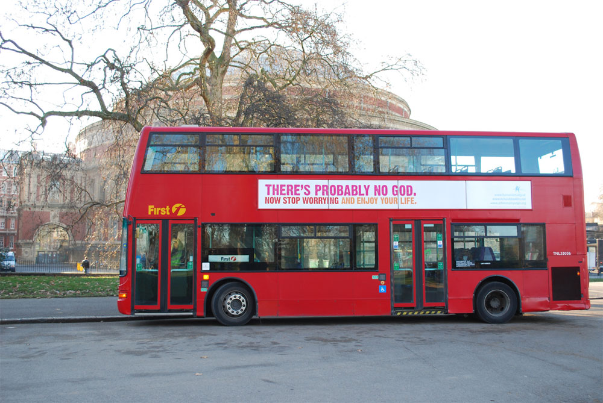
The atheist bus campaign
Notes:
This slide is probably only worth talking about if you have been asked to go into more detail on humanist beliefs about god
Ask children what they think this campaign was about
Ask why do you think the particular words were used in the advert?
‘Probably’: humanists believe we cannot know for certain whether a god exists or not (however, many humanists live their lives as though he does not)
‘Stop worrying’: many humanists think that religion and the distraction of an afterlife can cause us to avoid focussing on the good things in this life; we don’t need to be afraid
‘Enjoy life’: many humanists believe that because there is no afterlife, we need to enjoy this live - Robert Ingersoll, a nineteenth century American humanist, said, “The time to be happy is now!”

Slide 18
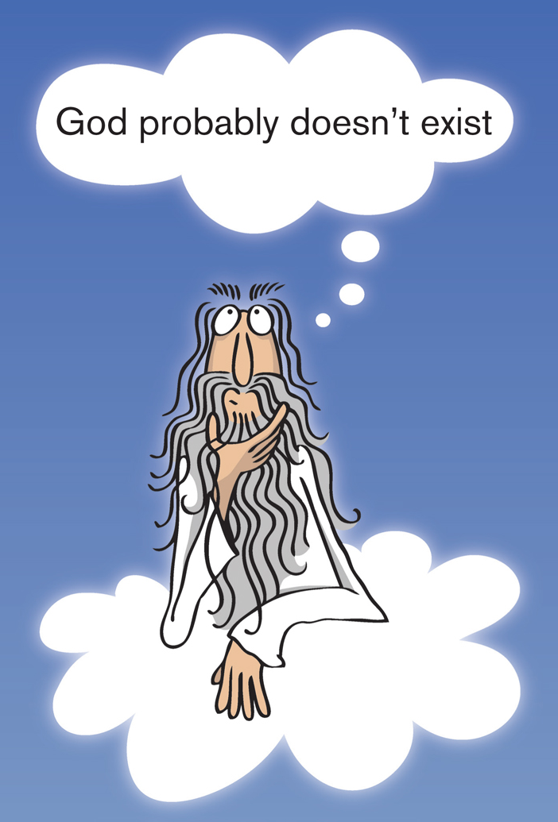
Question
What reasons do you think humanists have for not believing in a god or gods?
Notes:
Only use this slide if you’ve been asked specifically to address humanists non-belief in the existence of a god or gods
Best not to address arguments for and against the existence of god too deeply in a general introduction to Humanism unless the school / teacher wants you to
It is highly unlikely you will be asked to discuss such arguments in a primary school
You will probably have been invited to present what humanists believe in, not to present arguments against religion
Humanists don’t see any good evidence or reason to believe in a god. They don’t believe that many of the arguments put forward for the existence of a god constitute proof.
We are all atheists with regard to some gods – we all find some gods impossible to believe in. Almost everyone today rejects the existence of ancient gods such as Thor, Zeus, Apollo, Mithras, Osiris, Isis and Odin, yet once there were many people who believed in them and worshipped them for centuries. But there is no evidence for their existence. Humanists apply the same tests to the claims made for the existence of all the god people believe in today as to the gods of the past and, for that matter, to the existence of anything else. They ask what is the evidence?
Humanist responses to arguments for the existence of god
There are other explanations for revelation and miracles and plenty of evidence that prayer does not make a difference
The fact lots of people believe in something does not make it true
Beauty of the world – we have evolved to find certain things beautiful
Argument from design – Darwin explained it away
Ontological argument – flawed
Cosmological argument – just because we can’t yet fully explain the origin of the universe does not mean it needs to have been something supernatural – saying god created the universe, just pushes the question back a stage to ‘What created god?’
Pascal’s wager – which god should we believe in?
Explanations why people believe in god:
Influence of parents and society
Explain events we did not used to be able to explain: weather, disease, natural disasters
The need for meaning
Psychology
Many theological arguments for the existence of god are only evidence at their every best to support deism, not theism. If the god of deism does exist he/she is of no practical importance to our daily lives and so we can live our lives without concern for him/her. NB. Some people in history who identified themselves as humanists, or whom we can identify as being humanists, also claimed to be deists. However many modern humanists believe that if these people lived today, aware of our current scientific understanding of the universe, they would instead be atheists.

Slide 19

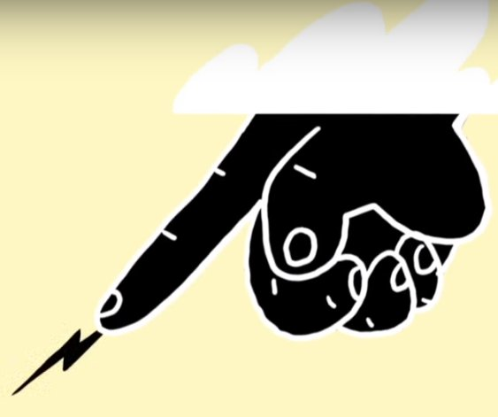
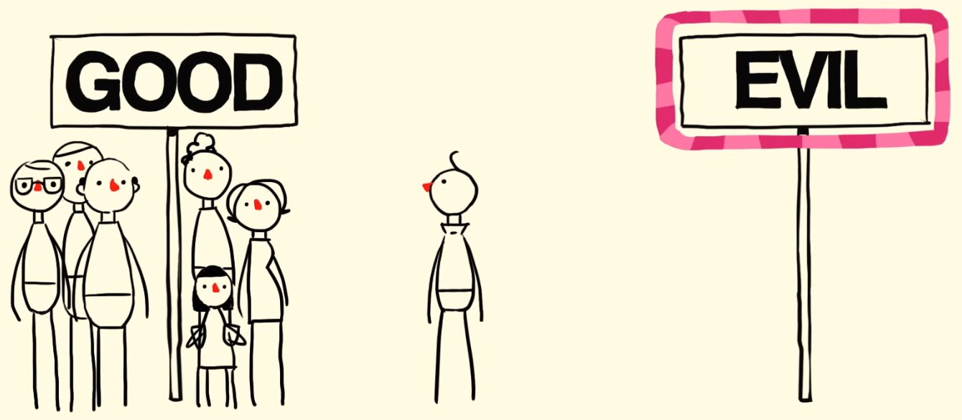
The Problem of Evil:
Why do bad things happen?
Why would a good, all-powerful god allow bad things to happen and people to suffer?
Notes:
Only use this slide if you’ve been asked specifically to address humanists non-belief in the existence of a god or gods
Best not to address arguments for and against the existence of god too deeply in a general introduction to Humanism unless the school / teacher wants you to
It is highly unlikely you will be asked to discuss such arguments in a primary school
Humanists would also argue that there are reasons why the existence of a benevolent god is unlikely, such as the presence of evil and suffering in the world.
The fact that bad things happen is a problem for those who believe in a benevolent (all-loving) god. Why would a good who is good and loves his creation allow bad things to happen?
For many humanists some events just seem so cruel that it is hard to believe a benevolent god would allow them (e.g. the Asian tsunami, the holocaust, the suffering of children). They accept that the problem of evil does not provide evidence against a malevolent or non-benevolent god or the god of deism.
‘I think of a parasitic worm that is boring through the eye of a boy living in West Africa, a worm that’s going to make him blind. Are you telling me that the God you say is an all-merciful God, that cares for each of us individually, are you saying that God created this worm that can live in no other way than in an innocent child’s eyeball? Because that doesn’t seem to me to coincide with a God that’s full of mercy’. (David Attenborough)
Their answer to the question why bad things happen is simply, because they do: that is just the way the world is. All bad things have natural explanations: human psychology and social conditions mean that some human beings are motivated to do things we disapprove of; our biological nature sometimes goes wrong so we get ill, and we age and die to make way for new life; and the physical forces that dictate the conditions of the world just happen to occasionally lead to natural disasters. Not everything needs a reason. Some things simply are.
NB. The response to many theological arguments including the problem of evil often depend on what belief position you start from.
Problem of evil is really two problems
1) Why do bad things happen? Not a problem for humanists
2) What can we do to prevent evil or deal with it when it occurs? Humanists concentrate on this
Some people argue that religious believers can cope better with suffering. Belief in an afterlife, it is argued, can help people to cope. Many humanists feel that belief in an afterlife and the idea that all wrongs will be judged after we die means that people sometimes simply accept cruelty and suffering rather than challenge it. For humanists this is the only life we have and so we should fight injustice where it exists and do all we can to prevent and respond to suffering from natural evil such as disease and natural disasters in order to make this the best life possible. They also believe in the great potential of human beings to be psychological strong and cope with suffering when nothing can be done to prevent it.

Slide 20
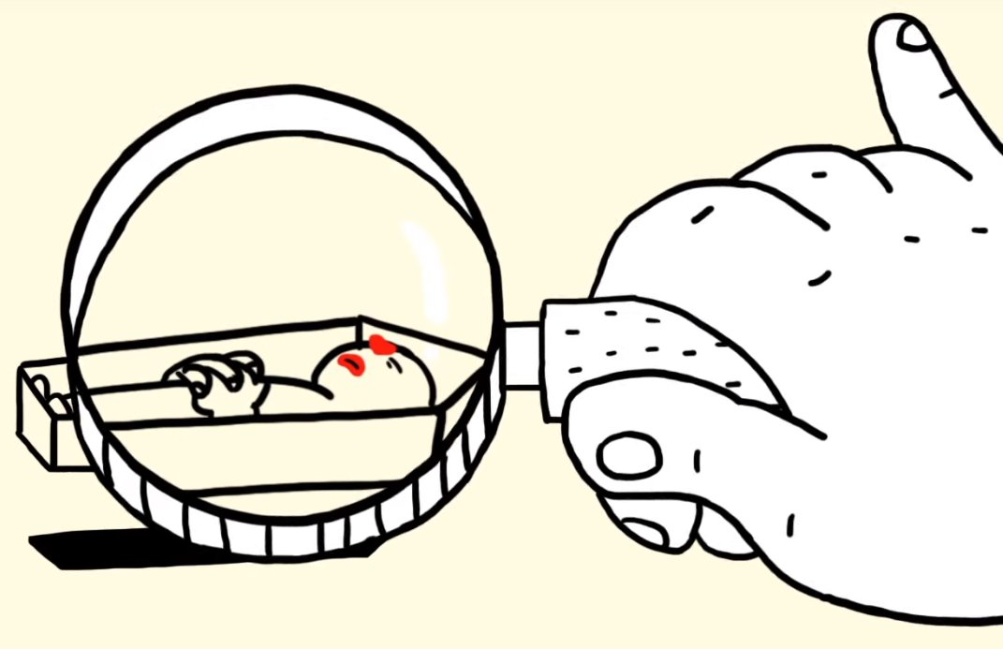
What do humanists think about death?
Humanists do not see any good evidence for an afterlife.
Therefore they do not believe in one.
Humanists are not afraid of death.
‘If death is bad then for whom is it bad? Not for the living, since they are not dead, and not for the dead since they don’t exist.’
Epicurus
Notes:
Be conscious of potential recent bereavements
Another thing humanists do not see any evidence for is an afterlife or another world
Humanists believe we are a body. We are made from matter alone; there is nothing immaterial about us. We do not have a soul. This belief is called materialism. It is in contrast with a belief called dualism: the idea that we have both a body and soul. Humanists do not believe we have a soul as, unlike the body, they do not see any evidence for it. The word human comes from the Latin word ‘humus’, which means ‘soil’, so ‘homo’ as in ‘homo sapiens’ means earth-being. For humanists, people are not distinct from nature. We are part of this world and this world alone.
It is important to note that this does not mean that humanists don’t recognise that human beings are extraordinary creatures. We have purpose, agency, forethought, will and the ability to question what we are and the world around us. We can create truly wonderful things such as skyscrapers, medicines, and literature. The fact we are only made of matter does not mean we are not special.
Explain that medical science currently says we are dead once our brain activity stops. For many humanists, modern science and medicine has given us a better understanding of the human body and mind that leaves no room or need for a soul. Most scripture was written and practices connected with the idea of an afterlife were introduced long before modern science helped us understand the nature of human beings. Yes, humanists accept we don’t know everything about the human body and mind, but they choose to only believe in what there is good evidence for. Humanists believe there is clear evidence that our body has ceased to be alive when we die (our bodies decay and eventually nothing survives) but there is no evidence that anything lives on.
The philosopher, David Hume, said we do have evidence of what it is like to be dead – when we are asleep. In dreamless sleep our minds undergo a temporary extinction and so we can imagine what it might be like to simply not exist. Some humanist also highlight the fact that we have no recollection of any experience before we were born so why should we think it would be any different after we die.
Ask the children to close their eyes and try to remember what it was like before they were born
Humanists believe the idea of an afterlife is a consequence of people’s fear of death. In the past people naturally felt the need for reassurance that death was not the end. It consoled them when loved one dies and made them less afraid of their own death.
Humanists also feel that ideas like heaven and hell and karma (in Hindu reincarnation) have been used to control people’s behaviour in the past. For most humanists, fear of punishment in the next life is not a good reason to behave well. There are many other reasons to behave well, such as the fact we should treat others as we would like to be treated ourselves, the fact that being good to others makes us feel good, and that it helps to make the world a better place.
Many humanists do not find the idea of there being no afterlife frightening. The ancient Greek philosopher, Epicurus, put forward the following reasons we should not be afraid of death:
‘Death is nothing to us (does not concern us), because as long as we exist, death is not here. And when it does come, we no longer exist.’
‘Anyone who fears death should consider the time before he was born. We do not consider not having existed for an eternity before our births to be a terrible thing; therefore, neither should we be afraid of not existing for an eternity after our deaths.’
‘If death is bad then for whom is it bad? Not for the living, since they are not dead, and not for the dead since they don’t exist.’
For many humanists, the state of being dead should be nothing to be afraid of. That does not mean that we should not try to avoid death; human life is valuable and many humanist believe we should make the most of the life we have. However, many humanists say death is a natural part of life and we must simply face up to this fact; they believe that human beings are psychologically strong enough to do this. They also argue that the finite nature of life is what gives it its structure, purpose and value. Good things are good because they do come to an end. A cake or a book that went on forever would begin to lose its appeal. So living forever might not be the best thing. They also highlight the fact that not all the possible afterlives put forward by religions are that appealing (e.g. hell, reincarnation).

Slide 21


Making the most of life
Notes:
Highlight the BHA’s tagline: for the one life we have
Some people think if there is not life for us after we are die then why would we bother to do anything. It is all a worthless waste of time. Most humanists disagree for two reasons. Firstly, by making the right decisions in life we can make ourselves and others happy in the time we do have. And secondly, in some sense, we do live on after we die.
For many humanists the more important question is not whether there is an afterlife but how we should live this life. Most humanists believe we must make the most of our lives while we are alive. For humanists, the time to be happy is now! We should be good to other people not because we will be rewarded in an afterlife, but because it can make us happy and makes this world a better place. They feel the idea of an afterlife can distract attention from this life. We know for certain that this life exists therefore we should focus our time and energy on being happy in this life.
‘We are all going to die, and that makes us the lucky ones. Most people are never going to die because they are never going to be born. The potential people who could have been here in my place but who will in fact never see the light of day outnumber the sand grains of Arabia’. (Richard Dawkins)
Is it so small a thing
To have enjoy'd the sun,
To have lived light in the spring,
To have loved, to have thought, to have done;
To have advanced true friends, and beat down baffling foes;
That we must feign a bliss
Of doubtful future date,
And while we dream on this
Lose all our present state,
And relegate to worlds yet distant our repose?
(Hymn of Empedocles, Matthew Arnold ,1822-1888)

Slide 22
Question
Even if there is no afterlife, how might we still ‘live on’ after we die?
Notes:
Explain the different ways humanists believe we do live on after we die or can at least have an impact on the world and other people after we die.
After our bodies break down, our atoms will go on to form other things
Our genes can live on in our children and grandchildren
Our actions, thoughts, and ideas can live on in the memories of others
Our works may live on after we die (e.g. things we have written, or painted, or built)

Slide 23
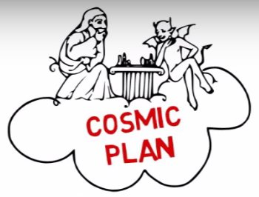


What’s life all about?
No ‘ultimate’ meaning
The meaning of your life is what you make it!
What is the good life?
Notes:
Many humanists believe that the question, ‘What is the meaning of life?’ often makes people believe there is some meaning beyond us, that there must be a bigger, grander meaning or purpose to life that lies outside ourselves. Many human beings feel the need for some kind of meaning to make them fell their lives are worthwhile.
However, many humanists believe that the meaning of life is not hidden and external to us but instead it is up to us to decide what the meaning and purpose of our own lives will be. Meaning is created not discovered. There is no ultimate meaning. We have the right and responsibility to give meaning and shape to our own lives. Some humanists prefer to not to talk of ‘meaning’ but rather talk about how we should live. They ask the question, ‘What is the good life?’ Humanist believe that just because they don’t believe in god/afterlife, does not mean they can’t be good and happy and live a worthwhile life.
There is not necessarily therefore one single answer to the question. Different people’s different preferences and talents can give rise to diverse ways of living. We should focus on our own personal development, call forth our individuality and cultivate it. We may also create many different meanings for ourselves as we go through life. Our attitudes and goals may change as we age. We can, however, all find meaning and happiness in our lives.
We are still all part of something bigger than ourselves; we are part of humanity and part of the natural world. It is just the case that for humanists, there is nothing supernatural about the greater forces around us.
For many humanists the finite nature of life and belief there is no afterlife is what gives it its structure, purpose and value.
The most important thing for a humanist is that it is up to the individual to decide what is of value in their lives and decide for themselves how they should live.
Ask children what are the ingredients of a good life?
How do they make their lives meaningful?
NB. The slide on happiness asks a similar question so don’t do this twice
Possible ingredients of a good life:
Eating and drinking well
Exploring and enjoying world
Keeping healthy
Being good to yourself
Making money
Making friends
Learning and discovery
Using your talents
Being creative
Contribute to our knowledge about the world
Working to create and discover things that will benefit mankind (art, science, politics)
Completing challenges
Helping others
Making other people happy
Being part of a community
Working to create a better world
Living in harmony with ourselves and others
Promoting shared human values: kindness, compassion, fairness, justice, honesty
‘I believe in living, the enjoyment of being, the fulfillment of our powers, the wonders of nature, the marvels of the cosmos. We don’t have to bother ourselves too much about what lies behind it all. It’s there. We are here. What is is. Our job is to get on with things, trying to make life better as we go.’ Claire Rayner (1931 – 2010)
‘The most terrifying fact about the universe is not that it is hostile but that it is indifferent; but if we can come to terms with this indifference... our existence as a species can have genuine meaning and fulfilment. However vast the darkness, we must supply our own light.’ Stanley Kubrik
‘In life, the meaning comes in living, as wholly as we can, as abundantly as we can, as bravely as we can, here and now, sharing the experience with others, caring for others as we care for ourselves, and accepting our responsibility for leaving the world better than we found it.’ James Hemming
‘You are an intelligent human being. Your life is valuable for its own sake. You are not second-class in the universe, deriving meaning and purpose from some other mind. You are not inherently evil - you are inherently human, possessing the positive rational potential to help make this a world of morality, peace, and joy. Trust yourself.’ Dan Barker in Losing Faith in Faith: From Preacher to Atheist (1992)
‘Try and be nice to people, avoid eating fat, read a good book every now and then, get some walking in, and try and live together in peace and harmony with people of all creeds and nations.’ Monty Python

Slide 24

Question
What does this symbol look like?
When might you stand like this?
Notes:
Ask the children to hold their arms up in the air like the happy human. When might they stand like that?
Happiness is so important to humanists that the symbol of many humanist organisations is the Happy Human. The symbol was chosen in a competition organised by the British Humanist Association (BHA) in 1965. It was designed by Dennis Barrington. The BHA used the original Happy Human in its own logo for some years and encouraged use of the symbol around the world, either in its original form or tailored for individual organisations.
It is a picture of a human being and is designed to look like an ‘H’ for ‘Human’ and ‘Humanism’. Explain that this symbol can make us think about being active and energetic as well as achieving and celebrating things. For humanists it is about celebrating being human.

Slide 25
The Happy Human
Humanists think we should try and find happiness in our lives and try to make other people happy.
What are the ingredients of happiness?
Notes:
Ask children for some of the ingredients of happiness
Then show them the next slide and see if they can come up with any more ideas

Slide 26


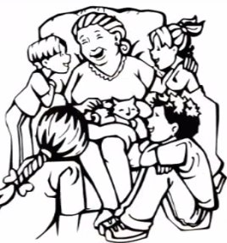


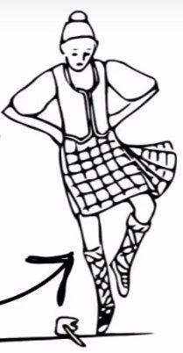
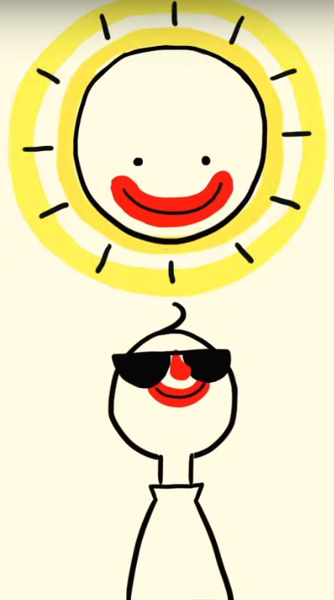



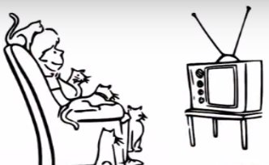
Happiness
Notes:
Possible ingredients of happiness:
Food and drink
Travel
Health
Money
Toys, games, and gadgets (possessions)
Friends
Family
Learning new things
Art, music, and literature
Being creative
Completing difficult challenges
Helping others
Making other people happy
Beauty and wonder of natural world and other living things
Many humanists believe that being happy is one of the most important things in life. Humanists believes that there are many different ingredients to happiness. Humanists believe that this life is the only life we have – they do not believe in an afterlife – they therefore believe it is important to be happy in this life. The time to be happy is now! Most humanists believe that it is important to find your own way to be happy and that this might be different for everybody.
It may seem obvious to many people that happiness is important. However, some people throughout history have questioned whether happiness should be a priority or whether other goals are more important, such as following rules.
Some people say that human beings should resist hedonism, enjoying certain bodily pleasures like food and drink. They say pursuing such pleasures does us no good. Humanists believe these pleasures can be important ingredients of a happy life as long we take our health into consideration when we decide whether to enjoy such pleasures. Many humanists, however, believe that real happiness involves more than just these bodily pleasures. The ancient Greek philosopher, Aristotle, used the word ‘Eudemonia’ to describe a wider sense of happiness – a way of flourishing in life – a way of living life to the full. This included building positive relationships, being curious and creative, and pursuing intellectual endeavours.
Some people may argue that thinking about happiness is a selfish way of living (you are only thinking about your own happiness) but most humanists think we should take the wellbeing of others and the environment into account when we decide how to act, and many also believe that one of the best ways to be happy ourselves is to make other people happy.
And one way to make others happy is to be happy yourself!
We don’t need to choose between being good and being happy.
‘The happy life is to an extraordinary extent the same as the good life’ Bertrand Russell
Possible extension questions:
Are any of these necessary / essential for happiness?
Is it possible to be happy with only one of these ingredients?
Do we need all of these to be happy?
Does everyone need the same things to be happy?
Does anything make everyone happy?
Is it possible to make everyone happy? What would be the best way to try?
What should I do when there are things that make me happy but others unhappy?
What stops people being happy? What things can make us unhappy? How can we overcome this unhappiness? Is it OK to sometimes not be happy?
Is anything more important than happiness?
Is happiness the purpose of life?

Slide 27
Happiness
‘Happiness is the only good. The time to be happy is now. The place to be happy is here. The way to be happy is to make others so.’
Robert Ingersoll

Slide 28
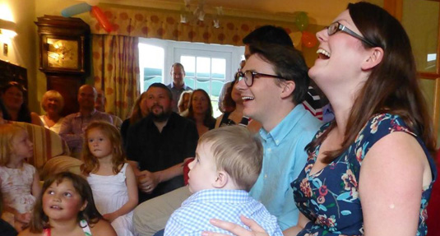
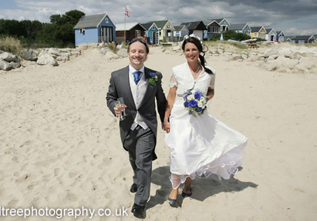
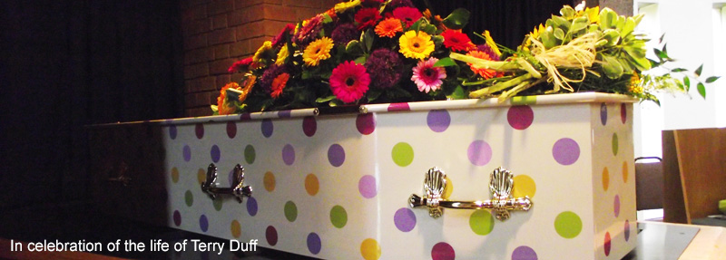
Celebration
Humanist celebrants carry out naming ceremonies, weddings, and funerals
Notes:
Just like religions, humanists take the opportunity to recognise and celebrate landmarks in people’s lives such as births, deaths and marriages and when people have achieved goals they have set themselves.
Humanists believe naming ceremonies are an opportunity to celebrate the arrival of a new human being. They are also an opportunity to acknowledge the support of friends and family and to make promises of love and support to the new baby. A humanist naming ceremony can be held wherever the parents like and the parents can decide what they want to say. Many humanists recognise how every new human has the potential to contribute to the good and progress of humanity. Every new life should therefore be acknowledged and celebrated.
Marriage or civil partnership is the formal union of two people as partners in a relationship. A wedding is an occasion to celebrate the marriage of two people. Many non-religious people get married in a registry office and this is necessary to make the marriage legally binding. Some humanists want to do more to celebrate and therefore arrange a humanists wedding. Both parties are encouraged to write their own vows (promises) to each other.
Humanists also have funerals. Sadness is often unavoidable, it is also very important to be able celebrate the life of someone you have loved, as well as take the time to grieve. There are no prayers but there is often time for silent reflection. For humanists, the funeral is an opportunity for the family and friends of the deceased to grieve, to share memories, and to celebrate the life of the person who has died. It is a profound and necessary occasion for those still living. Humanists believe that we live on in the memories of family and friends and those whose lives we have touched.
A humanist naming ceremony, wedding, or funeral is carried out by a humanist celebrant who helps create and plan the day and is there to make sure everything runs smoothly.
Humanists do not believe in gods or are at least are uncertain if they exist. Therefore they believe we need the love of other people, particularly family and friends, to help us in life. For humanists, the love, commitment, and support of our family and friends is really important. We have a responsibility to take care of each other. Humanist ceremonies will therefore focus on these ideas.
For further information, please visit https://humanism.org.uk/ceremonies/

Slide 29

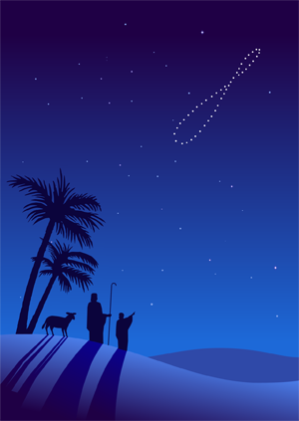
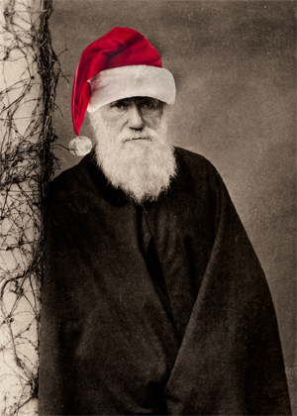

Question
Why do you think a humanist might celebrate at Christmas time?
Notes:
People often wonder what humanists do at Christmas or Easter, which are essentially Christian festivals. Like most people, humanists enjoy holidays, exchanging presents, seeing family, going to parties – and are quite happy to have holidays to cheer up the darkest days of winter and to welcome the beginning of spring or the new year. Many of our festivals are much older than Christianity, and were simply adopted by early Christians as good times to celebrate.

Slide 30
Why be good?
I wouldn’t like it if other people did bad things to me so I shouldn’t do bad things to other people.
If I’m not good I might get in trouble and be punished.
It’s against the law to do bad things.
If everyone did bad things, then the world wouldn’t be a nice place to live.
Notes:
Humanists believe we should be motivated to do good rather than bad actions because:
We should not do to others what we would not like them to do to ourselves
Doing the right thing to each other can make the world a better place
Making others happy can make us happy
Humanists don’t believe in an afterlife or in karma and so don’t believe our actions will be punished or rewarded by a god or gods. They don’t believe you need to believe in a god or an afterlife to have a reason to do the right thing. We may be punished or rewarded by those around us or the law. Many humanists, however, believe that although fear of punishment can make people avoid bad actions, this shouldn’t be the only reason why we don’t do bad things. We should avoid bad actions because we can empathise with other people’s feelings and imagine what it would be like to be in their position. We can also think about the wider consequences of our actions on the world we live in.
‘Being a Humanist means trying to behave decently without expectation of rewards or punishment after you are dead.’ Kurt Vonnegut

Slide 31
Question
Can you think of a good rule that can help us decide how we should behave?
Notes:
You could begin by asking:
Do we need rules?
Is it ever OK to break a rule?
Extension questions about rules:
Where do rules come from? (School, parents, the government, the law, religious leaders, holy books)
Do rules always help?
What are your school rules? Imagine no school rules: what would happen?
Some people think that rules can help us to make decisions when faced with a moral dilemma. Sometimes people want someone to tell them what to do as they feel it makes life easier. However, most humanists feel we need to take responsibility for our actions ourselves; rules can take away that responsibility. Most humanists also believe that inflexible rules can often complicate rather than solve dilemmas. Rules often contradict each other, so we can be left asking which rule we should follow.
Sometimes it can be Ok to break a rule (e.g. it might be OK to lie if the school bully asked you where your friend was). We should think carefully about the potential consequences of our actions and put questions about whether an action will lead to harm, before consideration of whether we are following prescribed rules. Humanists won’t simply take a rule or commandment for granted.
There is a rule, however, that humanists do think is important to try and follow.
Ask children how they feel when someone is unkind to you?
Ask them to freeze frame their faces to show how they would feel.
Now ask them to do the same for how they feel someone else would feel if someone was unkind to them.
Did their faces change? What does that tell us?
Empathy: other people have feelings too that are often very similar to ours
This allows us to consider The Golden Rule

Slide 32

The Golden Rule
‘Treat others as you would like to be treated yourself’
‘Do not treat others in a way you would not like to be treated’
This rule is found all over the world
Would the Golden Rule make a good school rule?
Notes:
Ask children what they think this rule means. Can they give any examples? (e.g. don’t bully others if you would not like to be bullied)
Ask them if there is a difference between the positive and negative versions
Explain that this rule appears to be almost universal. It has appeared in many different religions and philosophies throughout history and across the world. Even Jesus felt the golden rule was more important than the other commandments (love was more powerful than law).
You could read out or show a few examples
"Do not do to others what you would not like for yourself.“ Confucious, 500 BCE
"Love your neighbour as yourself." Chrisitianity/Judaism (Leviticus, Matthew, Mark)
"None of you truly believes, until he wishes for his brothers what he wishes for himself." a saying of Muhammad, Islam, 7thC Century CE
"As you think of yourself, so think of others." Guru Granth Sahib, Sikhism, 1604 CE
"This is the sum of duty: Do nothing to others Which, if done to you, could cause you pain." Hinduism, from the Mahabharata, about 150 BCE
"I will act towards others exactly as I would act towards myself." Buddhism, from The Siglo-Vada Sutta, about 500 BCE
Explain that many humanists do not believe this rule has a divine source but believe it is so universal is because it evolved naturally from the way our species has lived together in communities. It is a basic principle based on our common humanity, which grew from our ability to reason and empathise.
Some people have criticised the golden rule as they say it relies too strongly on our own idea of what is good for people. We must acknowledge that not everyone’s tastes and opinions are the same. Many humanists, however, think the negative version of the golden rule is worth following. We can be more confident that if there is something we would not like to happen to us then we should not do it to someone else. Also used correctly, the golden rule applies not to our specific likes and dislikes but on a level above them, our desire to have our interests taken into account, our wishes fulfilled, and our fears avoided.

Slide 33
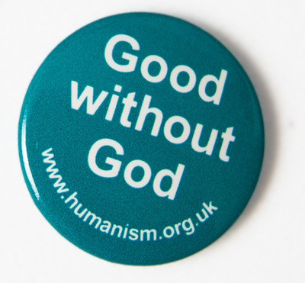
Can we be good without gods? Yes!
How do humanist decide what to do?
We must decide for ourselves!
If we do, we can make the world a better place
Empathy
Reason
Particular situation
Respect
Evidence
Notes:
Humanists don’t allow rules or figures of authority to command how they must behave: we must decide for ourselves, we need to take individual responsibility
Humanist believe human beings have the right tools to help them decide what is right and wrong.
Empathy is the ability to imagine ourselves in another’s place can ask how we would feel if we were in their situation.
Compassion is the desire to help others who are suffering.
Empathy, compassion and The Golden Rule have led us to develop other values such as:
Fairness
Equality
Recognising the dignity of all
Recognising the freedom of individuals
Reason is the capacity to work things out. We use reason when we apply logic and consider the facts to come to a conclusion. Humanists believe that we must use reason and evidence to decide what to believe and also how to act.
Many humanists believe everyone should be free to live their lives however they wish, as long as their actions don’t harm other people or the environment. This requires a balance between individual autonomy and social responsibility. Humanists are not therefore relativists: we can’t all decide how we want to live without thinking about others.
Thinking about the consequences of your actions is called consequentialism and promoting the greatest happiness is known as utilitarianism. We should judge people’s actions based on their effect on other people’s wellbeing. We should also consider every person not just a favoured few.
‘Actions are right in proportion as they tend to promote happiness, wrong as they tend to produce the reverse of happiness.’ John Stuart Mill
‘Create all the happiness you are able to create, remove all the misery you are able
to remove, and act for the greatest happiness of the greatest number.’ Jeremy Bentham
The philosopher Immanuel Kant said that we should always treat people as ends in themselves not as means to some other end. This means we shouldn’t use other people for our own happiness. We are all equally valuable. Kant also argued that we should only act in a way which we would be happy that everyone acted in the same way in the same situation (we would be happy that it became a universal moral law).
‘Always treat other people as ends in themselves, never as means to an end.’ Immanuel Kant

Slide 34
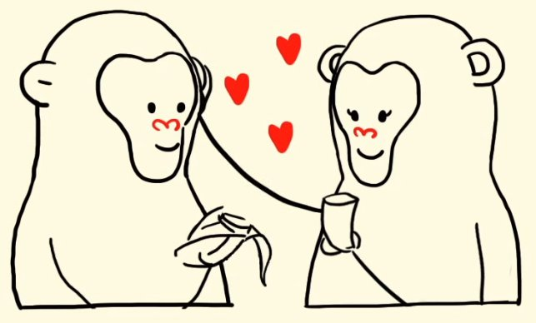
Being good is part of our nature
Notes:
Humanists believe our morality and ability to do the right thing have evolved naturally. We are social creatures with social instincts. Altruism has its roots in biology: is built into our genes. It is not humans alone who display empathy and compassion for each other. Animals do too. Our pro-social behaviour and the things we value have evolved alongside us, through both our evolutionary and social history. Morality does not come from a divine source: humanity was not dragged into a civilized state but it evolved naturally.
‘Why should I consider others? I think the only possible answer is the humanist one – because we are naturally social beings; we live in communities; and life in any community, from the family outwards, is much happier, and fuller, and richer if the members are friendly and co-operative than if they are hostile and resentful.’ Margaret Knight
However, we cannot always be guided by our instincts. We now live in a very different world from the world our ancestors evolved to survive in and inappropriate biases, prejudices and fears linger on. However our ability to reason allows us to rise above our instincts and we are able to use it to recognise when our instincts are inappropriate.
Some have argued that human nature is self-interested: a person only helps another to make themselves feel better. However this putting the cart before the horse. Humans may get pleasure from helping others, but that is because they first desire the well being of the other person. The pleasure comes from fulfilling that desire. If it was the other way round then that would mean someone who has no concern for the well being of others would still gain pleasure from helping them and therefore act accordingly.
Humanists accept that there is not a magic answer to how to act in every circumstance. However, just because we face dilemmas does not mean humanists think we should abandon the project; it just means there is more thinking to be done. Humanists believe the different tools and principles we have can help guide us. We are able to consider which tools are the most appropriate to the particular situation.
We will make mistakes but we can learn from them. Morality is something we learn and experience through doing it. Humanists will also disagree with each other (and often with themselves) about the best course of action. However freedom of belief and the right to disagree, providing your arguments are based on reason, are essential to the humanist project. Disagreement can be positive: it enables dialogue and debate. It encourages us to recognise, empathise with and take into consideration opposing arguments. For humanists, morality is not fixed but an ongoing journey throughout our lives and across human history. Humanists are therefore allowed to change their minds. New evidence and arguments will often demand this. For humanists then, morality is a human construct: a human project, and one we can be immensely proud of.

Slide 35
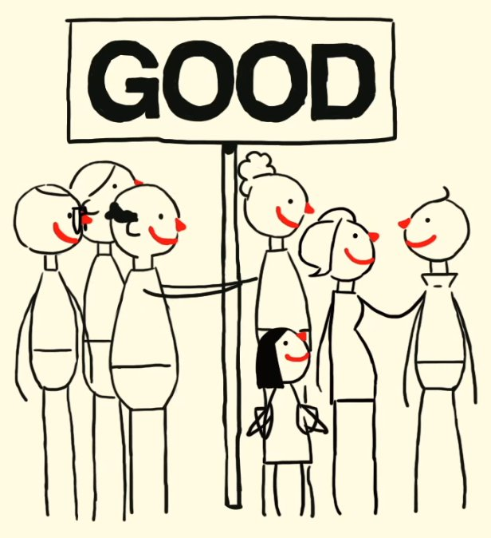
‘What do we live for if not to make the world a little less difficult for each other.’
Mary Ann Evans (George Eliot)

Slide 36
Humanism in practice
Humanists believe that humans alone are responsible for improving our quality of life on earth
Humanist thinking has had many positive effects on the world we live in
Today
Humanist celebrants
Pastoral care (prisons/hospitals)
Altruistic and charitable work
Notes:
Many humanists believe in using practical action to help make the world a better place for themselves and for others.
Advances in social justice and equality often have their origins in Humanist thinking
Often these have been opposed by the dominant religions of the place and time they occur
Development of science and technology
Abolition of slavery
Creation of welfare state
Rights of minorities
Played important parts in setting up organisations like the United Nations, the World Health Organisation, the Food and Agriculture Organisation, the Campaign for Nuclear Disarmament, and Oxfam.

Slide 37
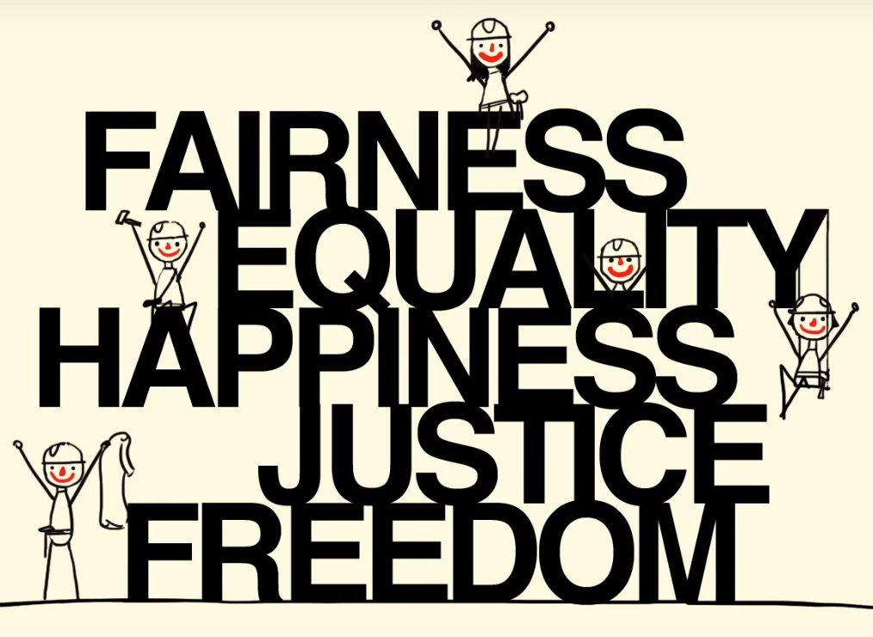
What kind of world do humanists want?
Humanists want:
Freedom of thought
Democracy
Human rights
Tolerance
Notes:
Secular State:
Definition: Secularism’ can mean different things to different people. The BHA use it to mean separation of church and state and equal treatment for all, regardless of religion or belief. Someone who supports secularism is a ‘secularist’, hence the BHA is a secularist organisation. The term ‘secular’ is occasionally used to mean something that is atheistic or agnostic, but the most common meaning is something that is simply not connected with religion or belief – for example, the Natural History Museum is a secular institution in this sense. When the BHA says something is ‘secular’ this is what we mean, as we think using it in this way is the clearest. ‘Secularisation’ is the process by which something, in particular society, becomes more secular (which might also mean it is becoming less religious but does not have to).
Freedom of thought, conscience, religion, and belief
Humanists support pluralism: the right of all religions and beliefs to exist
Community cohesion
Tolerance
Free speech:
Free speech does not say that all speech is OK, just that we should not restrict it
Beliefs and ideas should be open to criticism as they are things we can change - attacking the belief is not attaching the person
Humanists believe it is better to have a society in which we are all free but we are liable to be offended sometimes
Blasphemy - In some countries it is still against the law to speak out against religion
Executions in Saudi Arabia
Bangladeshi bloggers
Charlie Hebdo
Rule of law:
The legal system should govern a nation, not decisions of individual government officials
We should obey the law but it is acceptable to strive to change those laws you feel are unjust through peaceful means
Humanists believe religion has no place in setting the laws of the land
Human rights:
The Universal Declaration of Human Rights, which has gained wide international acceptance, is underpinned by a belief in shared human needs and values
Humans share a great deal in common – enables us to think about human rights
Humans can be very different from each other – alerts us to need for space and tolerance
Social justice:
This is the view that everyone deserves equal economic, political and social rights and opportunities, regardless of gender, race, religion or belief, age, sexuality, disability
Humanists believe in the principles of tolerance, justice, community, harmony
There are many causes of prejudice and discrimination:
Experience, upbringing, media, ignorance, scapegoating, even genetic influences?
A lot of prejudice stems from ideas about what is natural and what is not
Implicit bias
Humanists believe religions can discriminate unfairly: e.g. blasphemy/apostasy laws, no women priests, no same-sex marriage
Humanists think we should not put scripture and authority before thinking about whether the action does any harm
Humanists believe that the non-religious are unfairly discriminated against
Faith schools
No humanist marriages

Slide 38

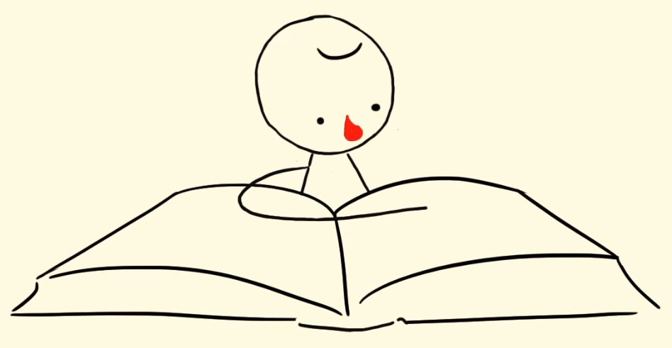
Wonder
Humanists see great wonder in the natural world and the achievements of human beings.
They want people to understand the world and each other. Understanding the world makes it more special to humanists.
Notes:
Humanists believe in the importance of Education
Special places for humanists
Natural world
Great achievements of mankind
Some people believe that the sense of wonder they get when viewing the natural world or listening to music is evidence of god or something outside this world
Numinous: the feeling there is something more powerful than you
Humanists get this feeling too but they don’t attach any supernatural meaning to it
They agree that there is something bigger than ourselves: the natural world and the whole of humanity – we are a part of something bigger than ourselves

Slide 39

What does it mean to be a humanist?
You can’t be born a humanist
Many humanists do not know they are humanists
Humanists have no obligation to participate in organised Humanism
Notes:
Humanists believe you can’t be born with any religion, your parents can’t decide what you believe, it is up to you
You can be humanist without knowing the word or having labelled yourself as such. Many people live their lives as humanists, with humanist beliefs and following humanist values, without ever identifying themselves as humanists (often because they are unaware of the word or what it means).
The British Humanist Association often get people who write to them following events and say things like:
‘Now I know what I believe!’ and
‘I see now though that I have been a humanist for many years in terms of ethics and moral values at least without either realising it or articulating it.’
Some humanists do like to meet in communities: local groups, BHA
Others prefer to just spend time with family and friends

Slide 40


The British Humanist Association
The BHA is a charity founded in 1896
It has over 40,000 members and supporters
What does the BHA want?
We want a world where everyone lives cooperatively on the basis of shared human values, respect for human rights, and concern for future generations.
We want non-religious people to be confident in living ethical and fulfilling lives on the basis of reason and humanity.
Notes:
BHA promote Humanism, work on behalf of the non-religious, and support those who wish to live humanist lives, including through the provision of humanist ceremonies.
We campaign for a secular state, challenge religious privilege, and promote equal treatment in law and policy of everyone regardless of religion or belief.
We offer a humanist perspective in public debate, drawing on contemporary humanist thought and the worldwide humanist tradition.
Mention AHS (National Federation of Atheist, Secularist and Humanist Student Societies) and Young Humanists (for humanists aged 18-35) sections of the BHA.

Slide 41
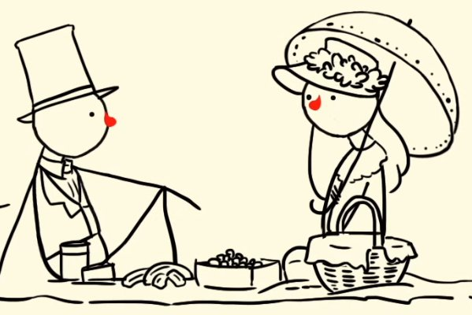
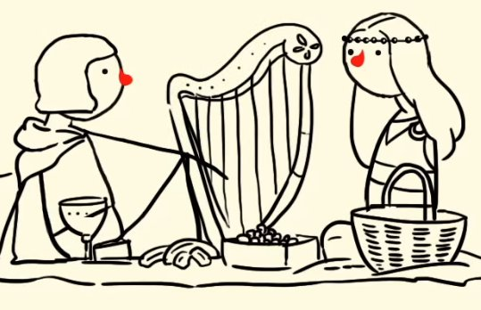
Humanist history
The humanist tradition is at least 2500 years old
China, India, Western Europe, and many other cultures
Many famous philosophers, scientists, and writers
Humanism has developed over time: not a fixed belief system but adapts as our species adapts
Today
Largest humanist organisations in Norway and India
The fastest growing are in Uganda and Nigeria
Notes:
Long history
Diverse manifestations
Humanism is not a fixed belief system but adapts as our species adapts
‘It is older by nearly a thousand years than Christianity and older by more than a thousand years than Islam. It is richer and more profound that either, and it is as fresh now as it was at its beginnings. It is, in fact, nothing other than the great tradition of philosophical debate about ethics, whose inception we attribute to Socrates.’ AC Grayling

Slide 42
The non-religious
Over half of the population of the UK say they have no religion
British Social Attitudes Survey (2013)
Notes:
This is the most recent figure.
Question asked by the BSAS was: Do you regard yourself as belonging to any particular religion?
50% no religion
42% Christian
5% Muslim
(NB. 69% from age range 18-24 said no religion)
Question asked by the 2011 Census was a more weighted question: What is your religion?
59% Christian
24% No religion
5% Muslim
Not everyone who is not religious is a humanist but a growing number are and many live their lives according to humanist beliefs and values even if they do not identify themselves as humanists.
Ipsos Mori in 2007 found that 36% of the population share humanist beliefs and values
YouGov in 2015 found that 5% identify themselves as humanist - greater than any non-Christian religion in the UK.
If you don’t believe in god or an afterlife, you are not alone. There are an enormous number of people like you out there who live happy, ethical, and meaningful lives.

Slide 43
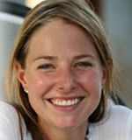
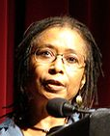
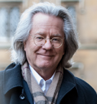

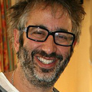
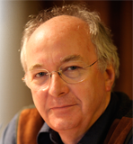

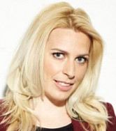

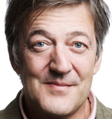
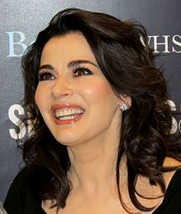


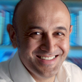

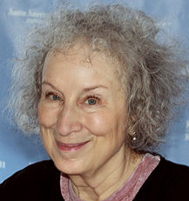

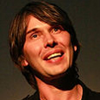
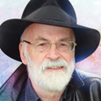
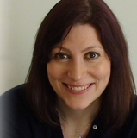
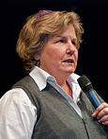
Who is a humanist?
Writers, philosophers, scientists, actors, comedians…
Notes:
Humanism is not some minority cult
We are the mainstream

Slide 44
Humanism is positive
More than just not believing in gods and an afterlife
Many positive beliefs and values
I believe I can be good without the need for religion
I believe I can make my own life meaningful
I believe science and reason can lead us to truths about the world
Helps human beings decide how to live their lives.
Notes:
‘The humanist view of life is progressive and optimistic, in awe of human potential, living without fear of judgment and death, finding enough purpose and meaning in life, love and leaving a good legacy.’ Polly Toynbee, journalist

Slide 45

Humanism is demanding.
However, it is also incredibly rewarding!

Slide 46
Understanding Humanism
Understandinghumanism.org.uk
39 Moreland Street
London
EC1V8BB

